Slide 1

Exploratory Data Analysis
G2M Investment for Cab Investment Firm
By: Ayah Ibrahim
6/20/2023

Slide 2

Agenda
Executive Summary
Problem Statement
Approach
EDA
EDA Summary
Recommendations

Slide 3
Executive Summary, Problem Statement, & Approach
This presentation seeks to present an analytical solution for a project undertaken by XYZ, a private firm in the US, to explore investment opportunities in the Cab Industry. In line with its Go-to-Market (G2M) strategy, XYZ seeks to understand the market dynamics before making a final investment decision.
The project involves analyzing multiple data sets related to two cab companies (Pink & Yellow), with each data set providing different aspects of customer profiles. The objective and our mission is to provide actionable insights to XYZ that will assist in identifying the most suitable company for their investment.
The findings and recommendations will be presented to XYZ's Executive team, with emphasis on the quality of analysis, visuals, and the value of insights.

Slide 4

We are provided 4 Datasets Needed to Implement the Analysis
Cab_Data.csv: Contains transaction details for the two cab companies.
Customer_ID.csv: A mapping table linking customer demographic details.
Transaction_ID.csv: A mapping table connecting transactions to customers and payment modes.
City.csv: Contains a list of US cities, their populations, and the number of cab users.

Slide 5
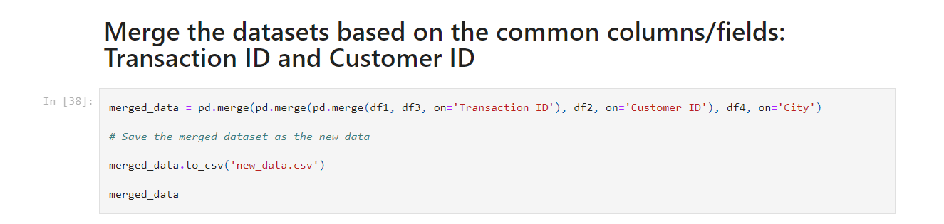
Exploratory Data Analysis
After viewing all 4 data sets' information, description, unique values, data types, and checking for duplicates, we will merge them to see what is common.

Slide 6
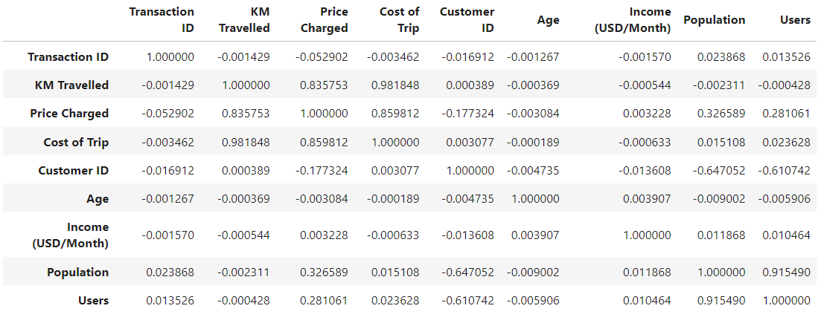
Numerical Visualization of the Correlation between the Merged Data
The closer the value is to 1, the stronger the correlation.
Based on this piece of information and the table on the right, we can conclude that there is a high correlation between:
- KM Travelled, Price Charged & Cost of Trip
- Population & Users

Slide 7
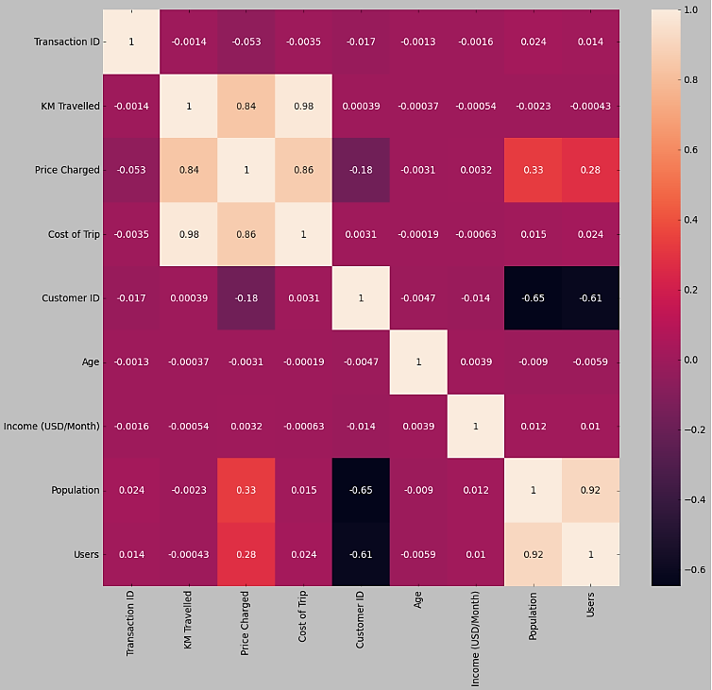
Heatmap Visualization of the Correlation between the Merged Data
The lighter the color of the block, the stronger the correlation.
Based on this piece of information and the table on the right, we can confirm that what we just concluded from the table on the previous slide to be true.

Slide 8
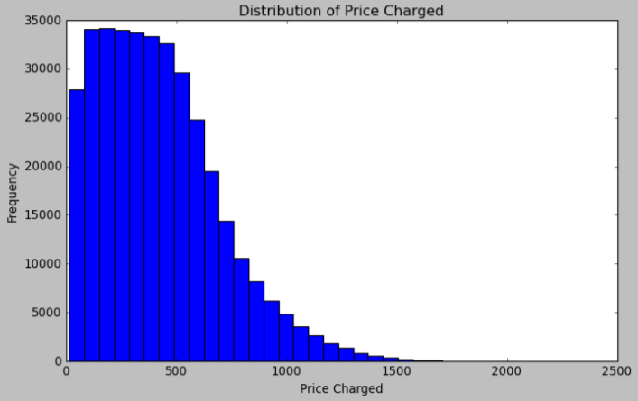
Distribution of Numerical Variables through Histograms: 2) Price Charged
This is a positively-skewed distribution suggesting that there is a higher frequency of low values (in this case price) and a lower frequency of high values or prices.

Slide 9
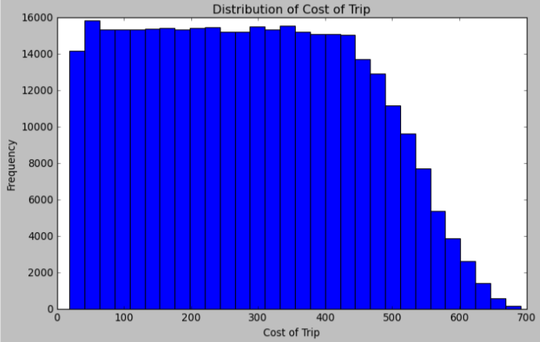
Distribution of Numerical Variables through Histograms: 3) Cost of Trip
Almost a uniform distribution with a slightly lower consistent frequency of larger values towards the end or right side.

Slide 10
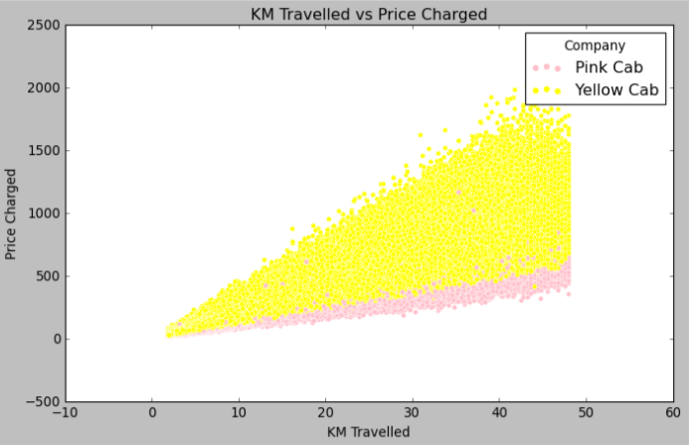
Scatterplot of Correlation between KM Travelled & Price Charged
This confirms the high correlation between the 2 variables.
Also, the Yellow Cab charges more than the Pink Cab as KM Travelled increases.

Slide 11
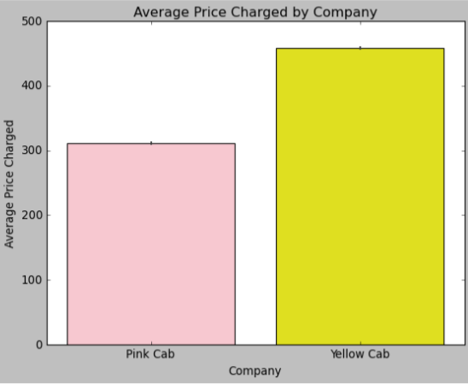

Hypothesis 1: The average price charged by the cab companies differs significantly.
We can conclude that there is a high difference between the average price charged in both companies with more in the Yellow Cab Company making our hypothesis true.
This also holds true for the trip cost of each company as shown below.

Slide 12
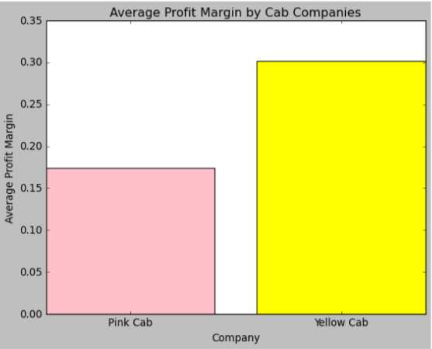

Hypothesis 2: The average profit margin of one cab company is significantly higher than the other.
This hypothesis is true. We can tell that the Yellow Cab's average profit margin is significantly higher than the Pink Cab’s.
The overall profit margin of the Yellow Cab company is also higher as shown below.

Slide 13
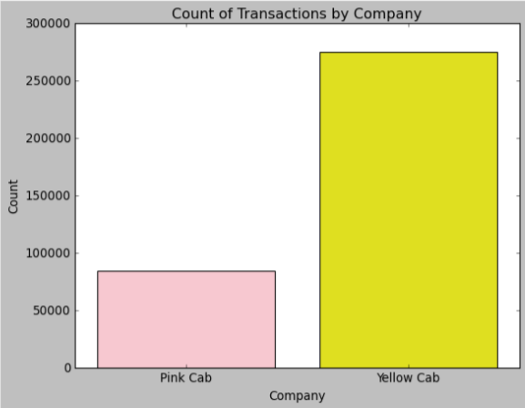
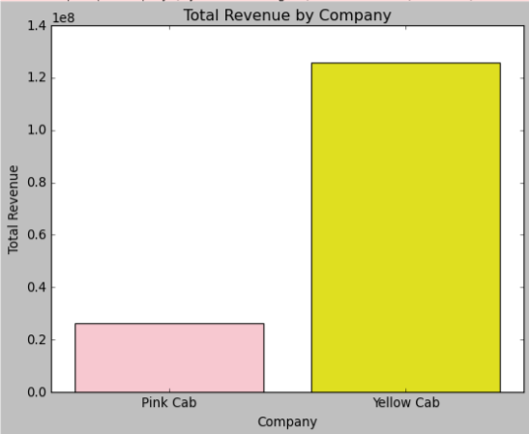


We can prove the previous 2 hypothesis through other data and observations as well:

Slide 14
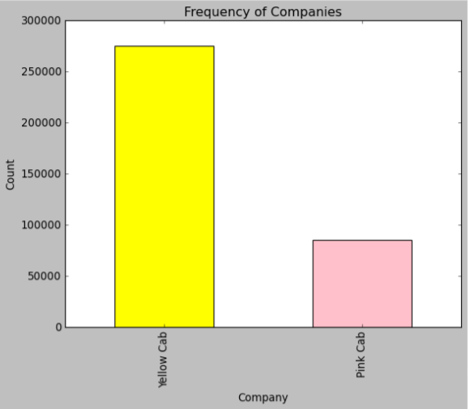

These bar plots suggest that hypotheses 1 and 2 are 100% true with the Yellow Cab company having a higher count of usage suggesting more customers, in addition to a higher number of transactions or sales for the Yellow Caba and thus, higher total revenue and profit.

Slide 15
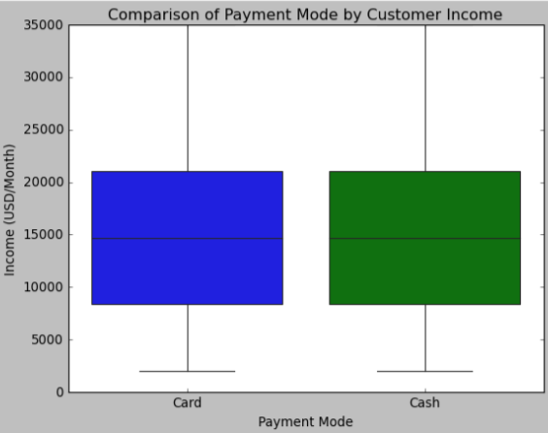
Hypothesis 3: The preferred payment mode varies based on the income level of customers.
This hypothesis isn’t necessarily proven to be true. The preference usage of the 2 different payment modes doesn’t seem to correlate with the income level of customers as there is almost equal usage between both modes for those of high and low income.

Slide 16
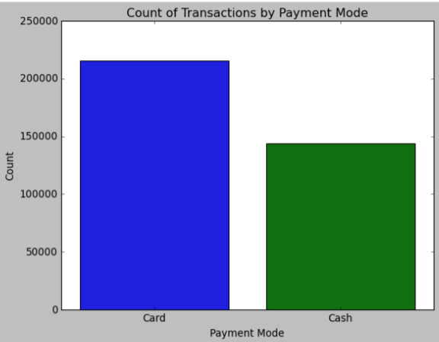
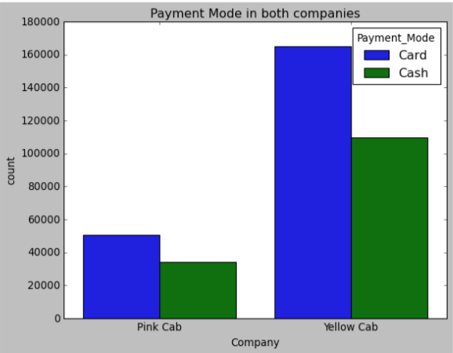
Regarding Payment Mode, we can observe other things:
These bar plots suggest that there are more card users than cash users and that there are more card users in the Yellow Cab company versus the Pink Cab company and overall more customers from the Yellow Cab.

Slide 17
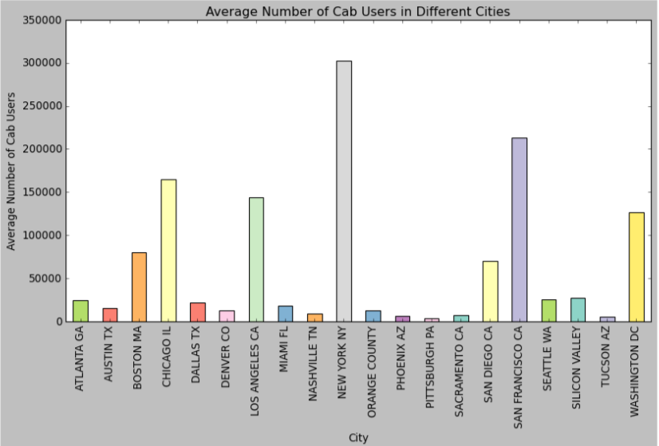
Hypothesis 4: Cab usage varies among different cities based on their population and number of users.
It is true that the average cab usage differs among cities with the highest usage being in New York NY, San Francisco CA, Washington DC, Chicago IL, & Los Angeles CA.

Slide 18
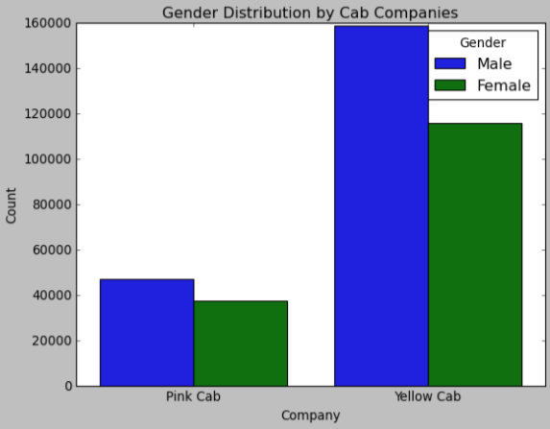
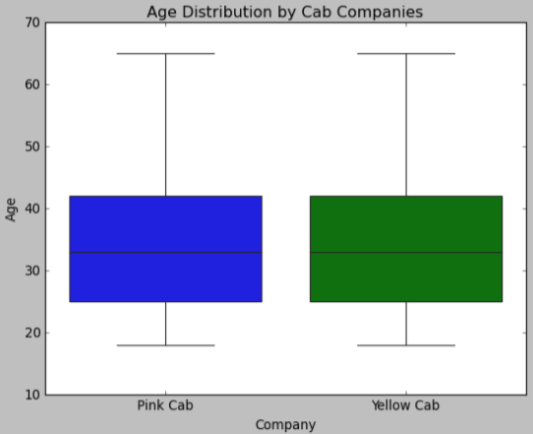
Hypothesis 5: Gender and age demographics of customers differ between the two cab companies.
Age distribution doesn't really differ between both companies, but males not only use cabs more than females but also use the Yellow Cab company more frequently than the Pink Cab company.

Slide 19
Recommendations & Conclusion
XYZ Firm should invest in the Yellow Cab Company because according to my analysis, Yellow Cab Company has:
1. Higher Profit Margin, Higher Total Revenue, and Higher Count of Transactions signifying more sales
2. More Users and Higher Population Usage signifying higher customer satisfaction

Slide 20
Thank you!

